Slide 1
Business Performance & Customer Analytics Overview
Period: 1997–1998
Prepared by : Shafana Shereef

Slide 2
Objective of the Analysis
The objectives of this analysis are to:
Evaluate overall business performance across Revenue, Profit, Sales, Customers, and Products
Identify key growth drivers and risk areas
Understand customer behavior and segmentation
Assess product and brand profitability
Provide actionable insights and strategic recommendations
Scope Covered:
Executive Summary
Sales Performance
Customer Analytics
Product Performance & Profitability

Slide 3
Dataset Overview
Time Period: 1997–1998
Total Customers: ~10,000
Total Transactions: ~270,000
Total Revenue: $1.76M
Total Profit: $1.05M
Key Dimensions Included
Time (Daily, Monthly, YTD)
Products & Brands
Store Type & Geography
Customer Demographics
Returns, Cost, and Price Adjustments

Slide 4
Methodology
Data Preparation & Tools
Jupyter Notebook
Used only to convert Date field from object to datetime
Power BI
Data cleaning and transformation
Data modeling and relationships
Measure and KPI creation
Dashboard and visual development
Visuals Used
Line, Bar, Column, Scatter, Matrix
KPI Cards and Slicers

Slide 5
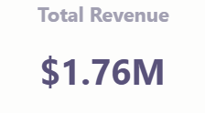
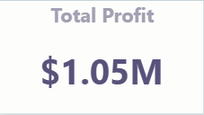
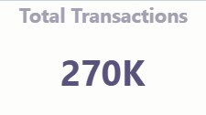
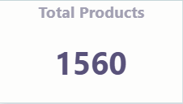
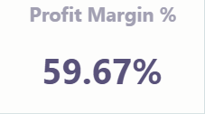
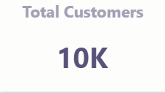
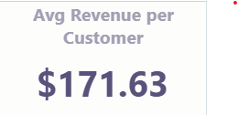
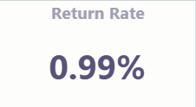
Key Metrics
Overall Performance KPIs
Insight: High margins and strong transaction volume indicate a healthy, scalable business model.

Slide 6
Business Performance Snapshot
Strong financial performance with ~60% margins and sustained revenue growth
1998 marks a growth inflection, with improved target achievement thereafter
Revenue anchored by top brands, yet well diversified overall
Large-format stores (Supermarket, Deluxe) drive scale with consistent margins
Profit growth is volume-led, not margin-driven

Slide 7
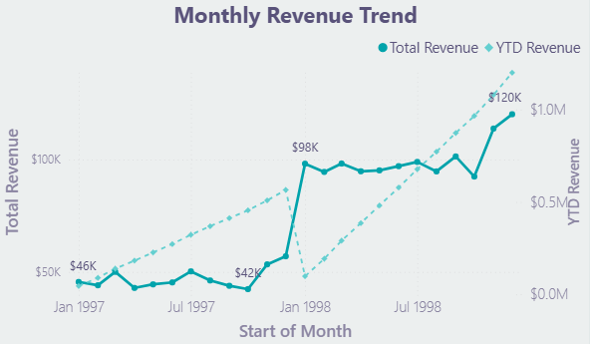
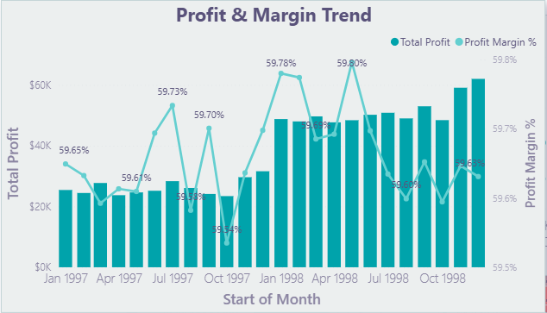
Performance Drivers & Trends
Revenue growth accelerates from early 1998
Profit growth driven by volume, not margin expansion.

Slide 8
Sales Performance Analysis
Transaction growth is steady and increasingly predictable, particularly in 1998
Demand is well distributed across top products, reducing SKU dependency risk
Salem and Tacoma outperform peers; execution outweighs city size
Revenue is concentrated in large store formats; smaller formats play targeted niche roles
Thursdays are peak transaction days, creating clear optimization opportunities

Slide 9
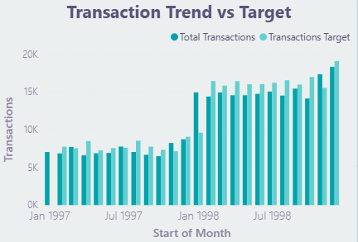
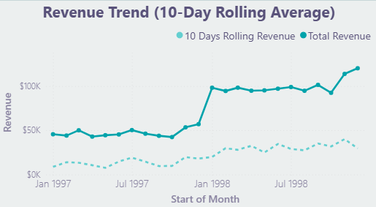
Sales Drivers & Optimization Opportunities
Transactions consistently meet or exceed targets.
Sales demand becomes steady and predictable over time.

Slide 10
Customer Analytics
Highest-value customers are middle-to-upper income ($30K–$90K), married homeowners
Customer base skews older, with repeat purchasing driving revenue stability
Professionals and skilled manual workers contribute the majority of revenue
Gender mix is balanced; value is driven more by life stage and household profile
Strong customer concentration in the West Coast, especially California

Slide 11
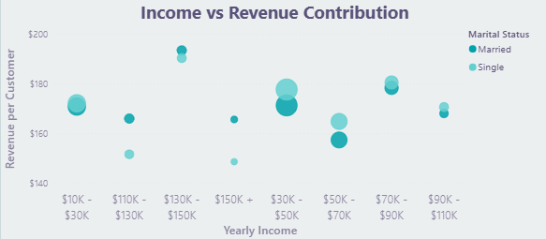
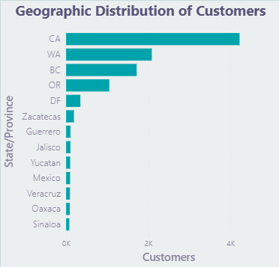
Customer Segments & Growth Opportunities
Revenue is driven by middle-to-upper income customers.
Customer value is concentrated on the West Coast, with room to expand.

Slide 12
Product Performance & Profitability
High revenue ≠ high profit; cost structure and returns drive net performance
Margins are consistently strong, limiting differentiation by margin alone
Returns and cost control are the primary levers for profit improvement
Some high-selling products suffer from structural cost inefficiencies, not demand issues
Targeted optimization of underperforming products can unlock outsized profit gains

Slide 13
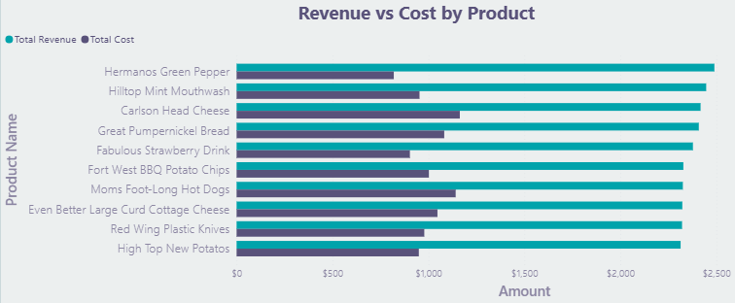
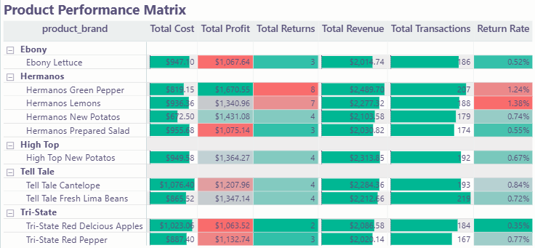
Product Profit Drivers & Optimization Opportunities

Slide 14
Executive Insight Summary
Structurally strong, high-margin (~60%) business with scalable, volume-led growth
Revenue growth accelerated in early 1998 and is now predictable and execution-driven
Large-format stores deliver scale without margin dilution; execution quality drives results
Revenue and demand are well diversified across products and customers, limiting risk
Core value comes from established, repeat customers with stable purchasing behavior
High revenue ≠ high profit; cost structure and returns determine net performance
Next-phase growth depends on operational efficiency and portfolio optimization, not margin expansion

Slide 15
Executive Recommendations
Scale volume through large-format stores and replicate best-in-class execution from top-performing locations
Prioritize cost and returns reduction in high-revenue, low-profit products to unlock immediate profit uplift
Focus growth investment on core customer segments (middle-to-upper income, homeowners, professionals) with proven repeat behavior
Use execution metrics over geography size to drive store-level performance management
Protect diversification while simplifying the product portfolio, fixing or exiting structurally inefficient SKUs
Pursue selective geographic expansion beyond the West Coast, testing Mexico with disciplined pilots
Track success via volume, cost, and return-rate KPIs, not margin expansion targets

Slide 16
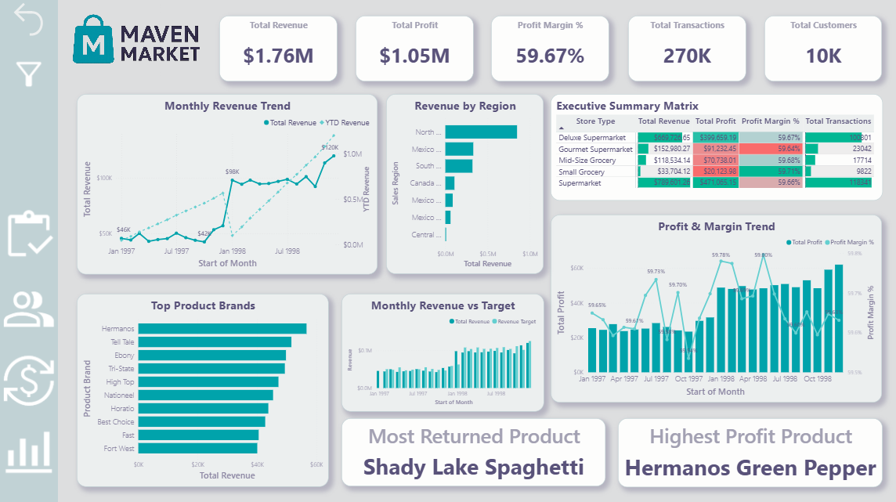
Executive Summary

Slide 17
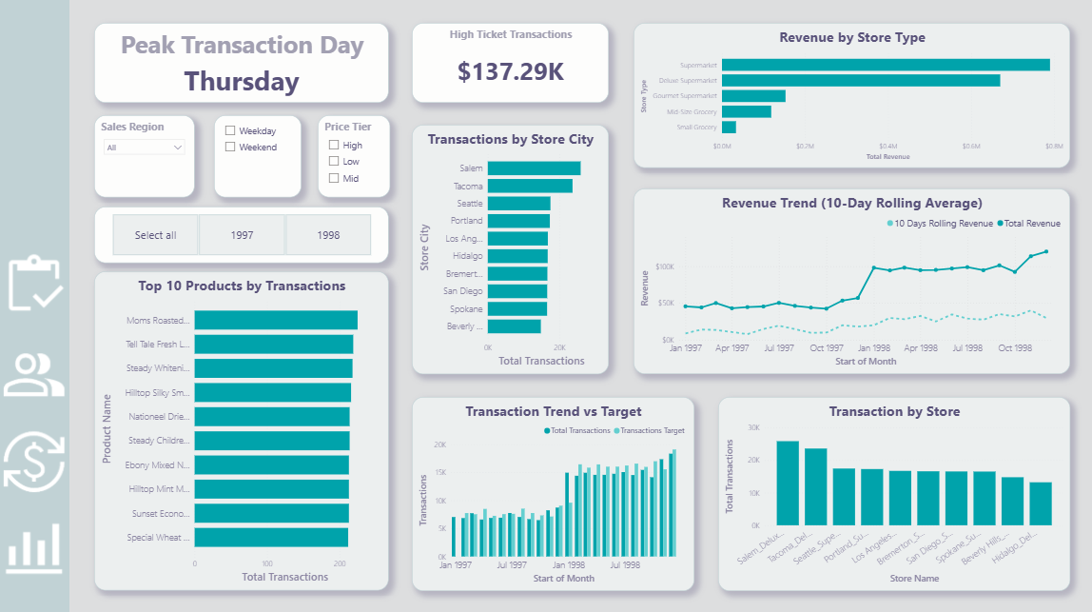
Sales & Transaction Analysis

Slide 18
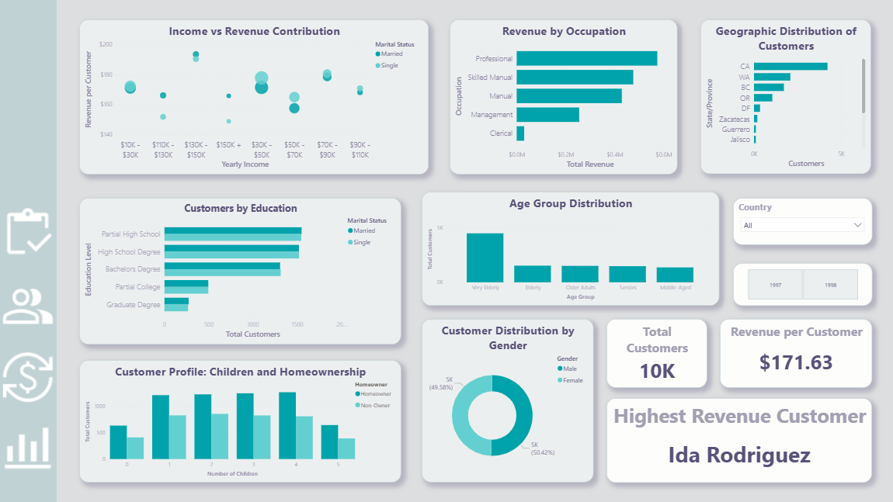
Customer Analytics

Slide 19
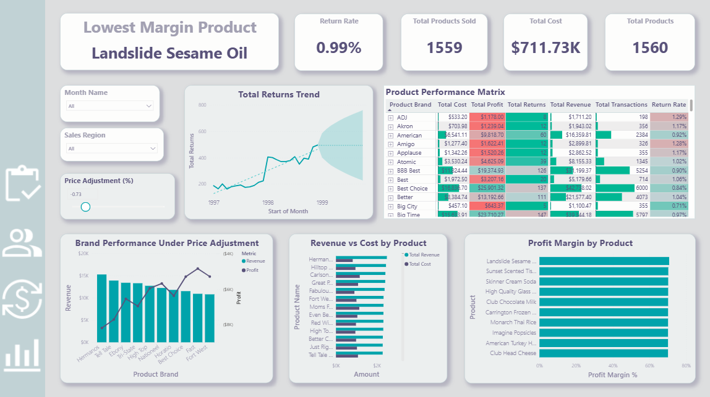
Product Profitability & Returns

Slide 20
THANK YOU !

